Slide 1

BCG Data Science Task 2
Vedant Kedia

Slide 2
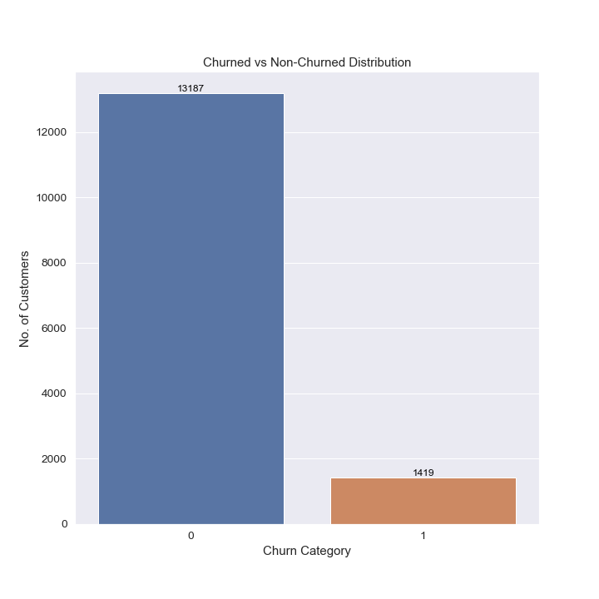
Churn Rate
Of PowerCo’s total customers, 9.7% have churned in the 3 months following the dataset’s last records

Slide 3
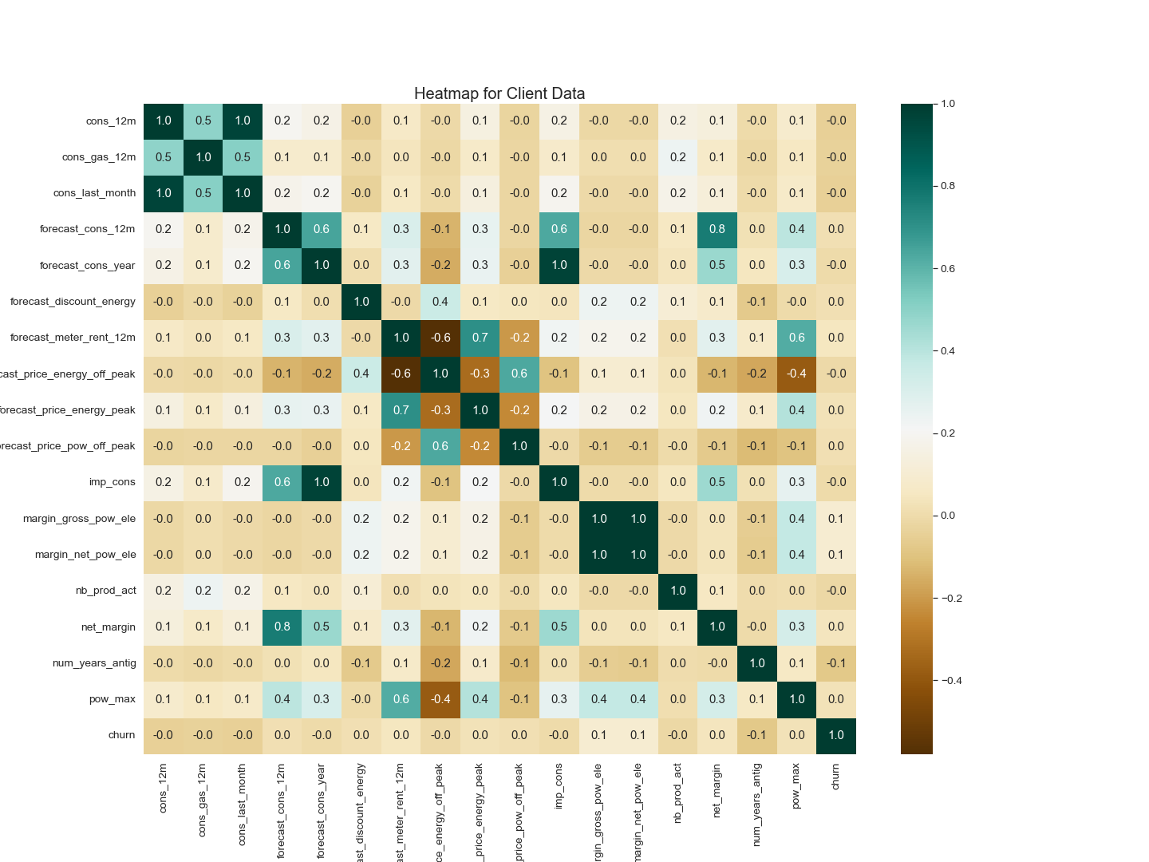
Correlations
Current consumption shows a 100% correlation with the forecasted consumption for the next calendar year.
Consumption of Gas is showing strong positive correlation with consumption of electricity
The forecasted consumption is highly correlated with the net margin.
Max power consumption shows positive correlation with margin.

Slide 4
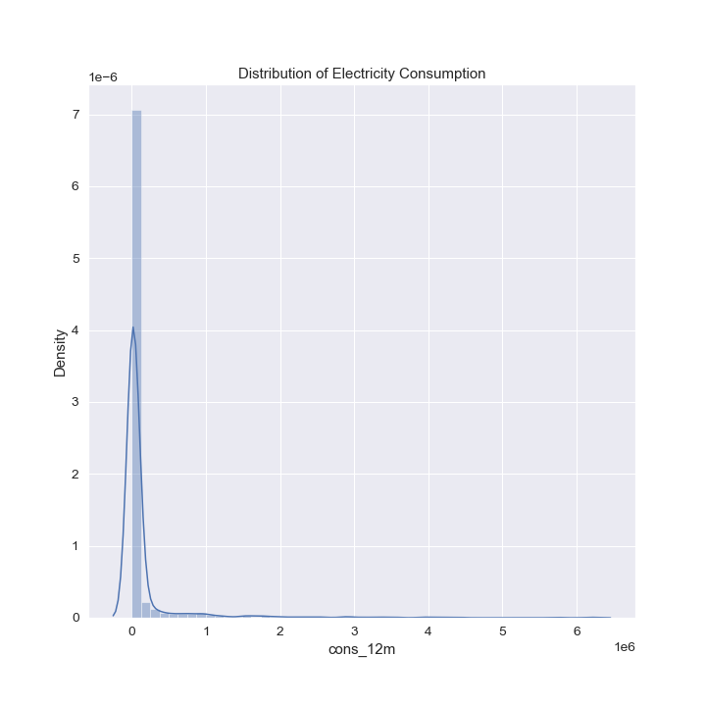
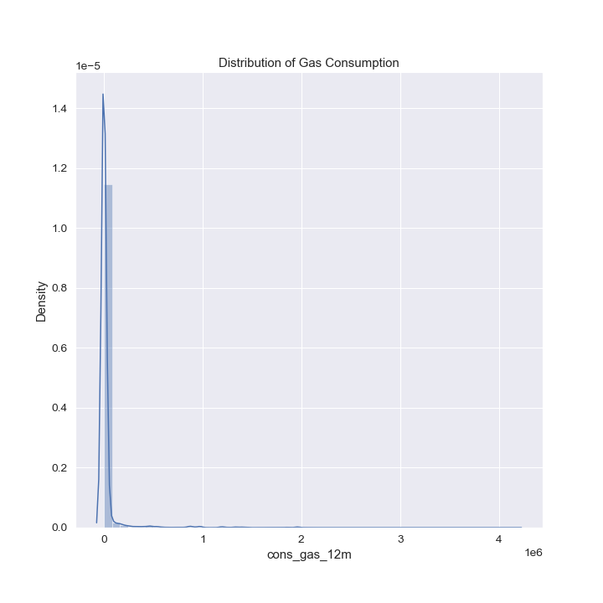
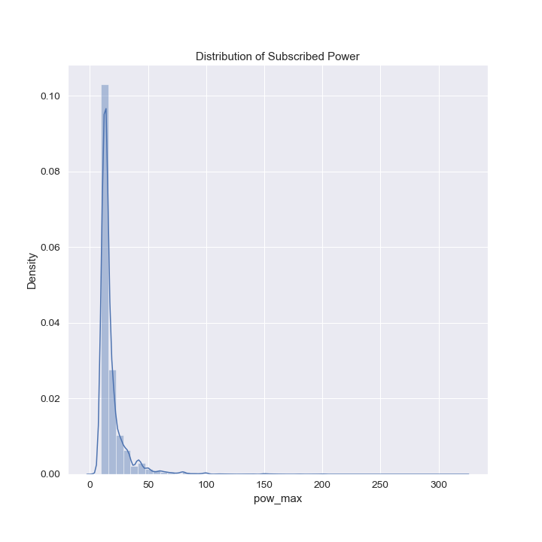
Consumption
Both electricity and gas consumption were highly skewed with the majority of customers consuming at the lower end of the spectrum and few consuming at the higher end. The same trend was visible with power subscription albeit to a lesser degree

Slide 5
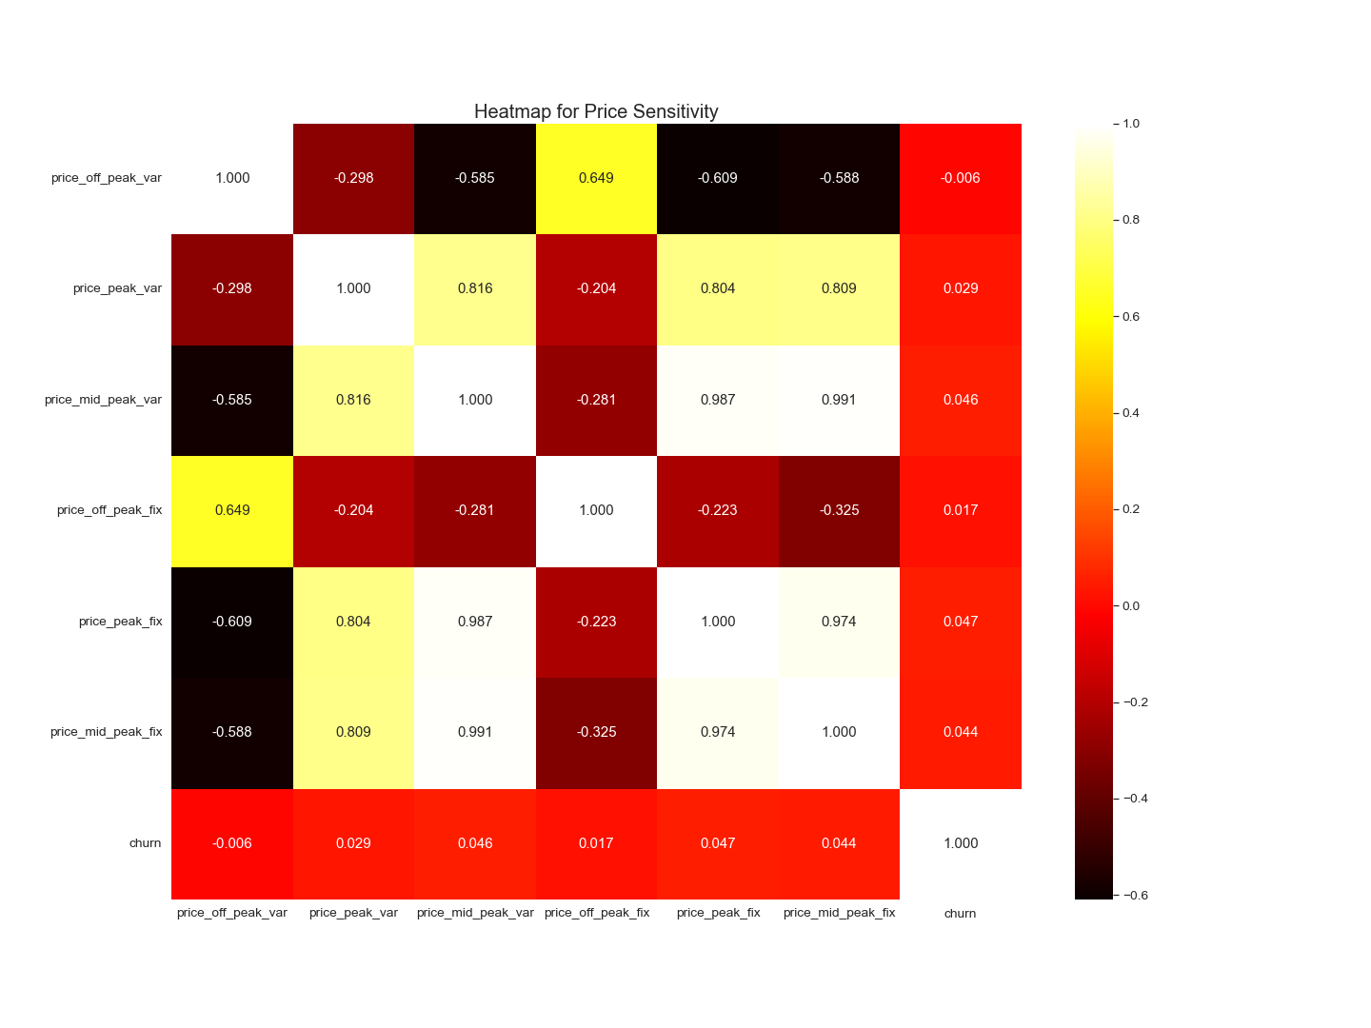
Price Sensitivity
Prices showed inconsistent correlation between variable and fixed rates
No price attribute showed significant correlation with churning decisions

Slide 6
Further Steps and Additional Data Sources
While prices may not have shown a promising correlation with churn, this is a preliminary analysis and may not be fully accurate.
To determine accurate price sensitivity, we would require average prices and consumption details at an equal date/time granularity.
Moreover data over the customer’s revenues would also assist in further analysis.
Measuring energy cost as a percentage of revenue will provide further insight into a customer’s budget for energy rates

Slide 7
Thank You

